Slide 1

Introduction to Decision Trees
Presented by:
Elizer Ponio Jr.
Department of Computer Science
College of Computing and Information Technologies

Slide 2
Outline
Introduction
SVM Terminologies
Types of SVM

Slide 3
I want have six pack abs
True
False
Go to the gym
Drink alcoholic drinks everyday

Slide 4
In general, decision trees make a statement
I want have six pack abs
And then makes a decision whether or not the statement is True or False
True
False
Go to the gym
Drink alcoholic drinks everyday

Slide 5
When a decision tree classifies things into categories,
I want have six pack abs
its called a classification tree
True
False
Go to the gym
Drink alcoholic drinks everyday

Slide 6
And when a decision tree predicts numerical values
I have an expensive phone
Its called a regression tree
True
False
It is between 20 to 100 thousand pesos
It is less than 20 thousand pesos

Slide 7
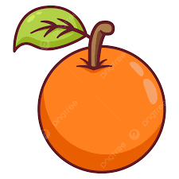
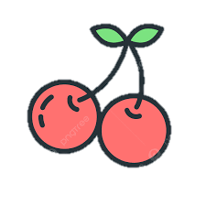

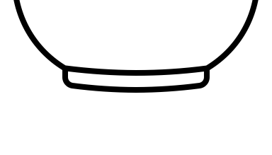
For the most part, classification trees are easy to work with
Is the color of the fruit red?
True
False
Is the shape of the fruit round/circle?
True
False

Slide 8
You start at the top
Is the color of the fruit red?
True
False
Is the shape of the fruit round/circle?
True
False

Slide 9
You start at the top
Is the color of the fruit red?
True
False
Is the shape of the fruit round/circle?
And work you way down
True
False

Slide 10
You start at the top
Is the color of the fruit red?
True
False
Is the shape of the fruit round/circle?
And work you way down
True
False
Until you get to a point where you cannot go any further and that is how we classify something!

Slide 11
Fruits Example
Is color red? | Is Round? | Diameter | Label
Yes | Yes | 1 | Cherry
Yes | Yes | 1 | Cherry
Yes | Yes | 1 | Cherry
Yes | Yes | 1 | Cherry
Yes | No | 5 | Apple
No | Yes | 6 | Orange
No | Yes | 7 | Orange
Yes | No | 7 | Apple
Yes | No | 8 | Apple
Yes | No | 9 | Apple

Slide 12
The first thing we do is decide is whether asking if the color is red or is the shape round should be the question we ask at the very top of the tree
????
True
False

Slide 13
To make that decision, we will start looking at how well asking if the color of the fruit is red
????
True
False

Slide 14
To do this, we will make a simple tree that only asks if the fruit color is red.
Is the color of the fruit red?
True
False

Slide 15
And then we run down the data to the tree
Is color red? | Is Round? | Diameter | Label
Yes | Yes | 1 | Cherry
Yes | Yes | 1 | Cherry
Yes | Yes | 1 | Cherry
Yes | Yes | 1 | Cherry
Yes | No | 5 | Apple
No | Yes | 6 | Orange
No | Yes | 7 | Orange
Yes | No | 7 | Apple
Yes | No | 8 | Apple
Yes | No | 9 | Apple
Is the color of the fruit red?
True
False

Slide 16
And then we run down the data to the tree
Is color red? | Is Round? | Diameter | Label
Yes | Yes | 1 | Cherry
Yes | Yes | 1 | Cherry
Yes | Yes | 1 | Cherry
Yes | Yes | 1 | Cherry
Yes | No | 5 | Apple
No | Yes | 6 | Orange
No | Yes | 7 | Orange
Yes | No | 7 | Apple
Yes | No | 8 | Apple
Yes | No | 9 | Apple
Is the color of the fruit red?
True
False

Slide 17
Let us do the exact same thing for the question “Is Round?”
Is color red? | Is Round? | Diameter | Label
Yes | Yes | 1 | Cherry
Yes | Yes | 1 | Cherry
Yes | Yes | 1 | Cherry
Yes | Yes | 1 | Cherry
Yes | No | 5 | Apple
No | Yes | 6 | Orange
No | Yes | 7 | Orange
Yes | No | 7 | Apple
Yes | No | 8 | Apple
Yes | No | 9 | Apple
Is Round?
True
False

Slide 18
Looking at our two simple trees, we see that neither one does a perfect job of predicting the label of the fruit.
Is the color of the fruit red?
Is Round?
True
False
True
False

Slide 19
Is the color of the fruit red?
Is Round?
True
False
True
False
Looking at our two simple trees, we see that neither one does a perfect job of predicting the label of the fruit.

Slide 20
Is the color of the fruit red?
Is Round?
True
False
True
False
Specifically, these two leaf nodes contain mixtures of fruits that have the different labels

Slide 21
Is the color of the fruit red?
Is Round?
True
False
True
False
Because these leaf nodes all contain a mixture of fruits with different labels, they are called Impure

Slide 22
Is the color of the fruit red?
Is Round?
True
False
True
False
And because both of our trees have a leaf node that is impure, how do we know which one do we ask first?

Slide 23
Is the color of the fruit red?
Is Round?
True
False
True
False
One of the most popular methods is called Gini Impurity, but there are also other methods like Entropy and Information Gain

Slide 24

Is the color of the fruit red?
Is Round?
True
False
True
False
Let us start by calculating the Gini Impurity of “Is the color of the fruit red?”

Slide 25
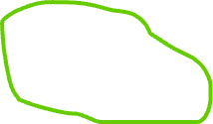

Is the color of the fruit red?
True
False
To calculate the Gini Impurity for “Is the color of the fruit red?”, we start by calculating the Gini Impurity for the individual leaves

Slide 26


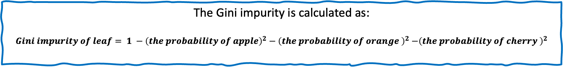
Is the color of the fruit red?
True
False
The Gini impurity is calculated as:
$$Gini impurity of leaf= 1 −{\left(the probability of apple\right)}^{2}−{\left(the probability of orange \right)}^{2}{−\left(the probability of cherry \right)}^{2}$$

Slide 27
Is the color of the fruit red?
True
False
The Gini impurity is calculated as:
$$Gini impurity of leaf= 1 −{\left(the probability of apple\right)}^{2}−{\left(the probability of orange \right)}^{2}{−\left(the probability of cherry \right)}^{2}$$

Slide 28
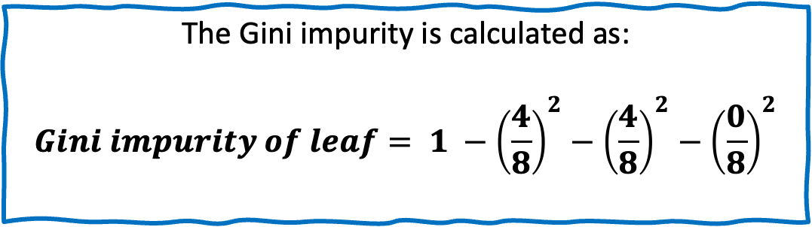
Is the color of the fruit red?
True
False
The Gini impurity is calculated as:
$$Gini impurity of leaf= 1 −{\left(\frac{4}{8}\right)}^{2}−{\left(\frac{4}{8}\right)}^{2}−{\left(\frac{0}{8}\right)}^{2}$$

Slide 29
Is the shape of the fruit round/circle?
True
False

Slide 30
References
https://www.ibm.com/topics/support-vector-machine#:~:text=What%20are%20SVMs%3F,in%20an%20N%2Ddimensional%20space.
https://www.youtube.com/watch?v=iEQ0e-WLgkQ&t=107s

